Slide 1
SLEEP HYGIENE
Bethany, Brianna & Jordan

Slide 2
Outcomes
Be aware of ways to improve your sleeping habits
Be able to correct poor sleeping routines
Understand the different types of mattresses and pillows
Acknowledge the benefits of good sleep hygiene

Slide 3
What is Sleep Hygiene
Sleep hygiene is “habits and practices that are conducive to sleeping well on a regular basis and is a variety of ways to get ready for bed.
Notes:
jordan

Slide 4
Why it is important
How it can affect the next day
Help you feel rested and not groggy
Won't be tired in the middle of the day
Maintains physical, mental, behavioral health
Good sleep can improve concentration and productivity
Can improve athletic ability because it gives your body time to heal
While you’re sleeping, your body is “resetting and healing”
Notes:
jordan

Slide 5
12 Tips for Getting Better Sleep
#1 Avoid Caffeine, Alcohol, Nicotine, and Other Chemicals that Interfere with Sleep
#2 Turn Your Bedroom into a Sleep-Inducing Environment
#3 Establish a Soothing Pre-Sleep Routine
#4 Go to Sleep When You’re Truly Tired
#5 Don’t Be a Nighttime Clock-Watcher
#6 Use Light to Your Advantage
#8 Nap Early—Or Not at All
#9 Lighten Up on Evening Meals
#10 Balance Fluid Intake
#11 Exercise Early
#12 Follow Through
Notes:
jordan

Slide 6
Ways to Get Sleep Hygiene
Baths/Hot Tubs
Taking a hot bath or shower can help you relax before bed
There are many safe options for bathtubs to prevent falls
Diet
Some foods can keep you up at night like caffeine
By not eating past 7, this will help your digestion and help your sleep be deeper.
How much sleep do you need?
Depends on your activity level
Typically 7-8 hrs a night
Notes:
beth

Slide 7
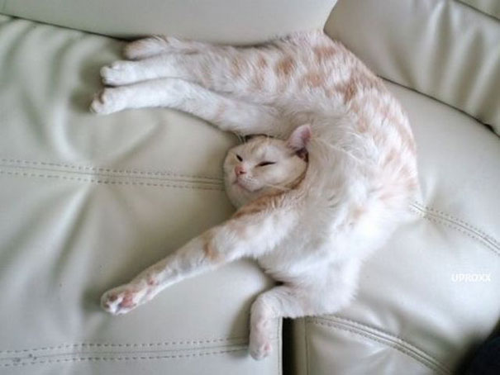
How Can I Improve Sleep Hygiene?
Routine before bed
Go to bed at the same time every night
Wake up around the same time every morning
Sleep environment
Try to avoid bright lights in your bedroom while you are sleeping
Keep sounds to a minimum
Exercising
Physical activity increases time spent in deep sleep. Deep sleep helps to boost immune function, support cardiac health, and control stress and anxiety.
Avoiding caffeine near bedtime
About 6 hours before sleeping
Notes:
beth

Slide 8
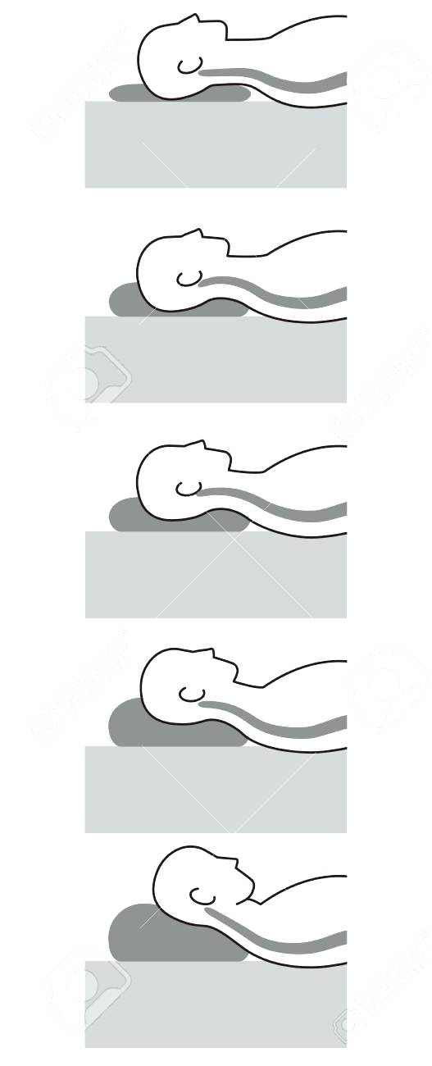
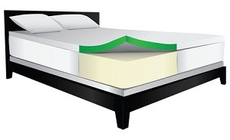
Different Types of Mattresses and Pillows
Mattress Types
Memory Foam
Gel
Pillow Top
Inner Spring
Water Bed
Air Bed
Adjustable
Pillow Types
Feather
Down
Memory Foam
Microbead
Notes:
beth

Slide 9
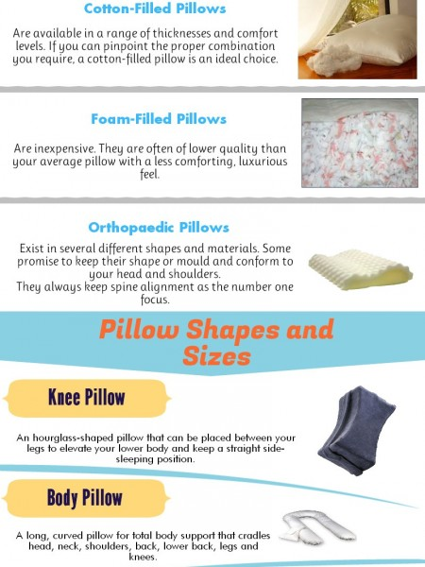
Notes:
beth

Slide 10
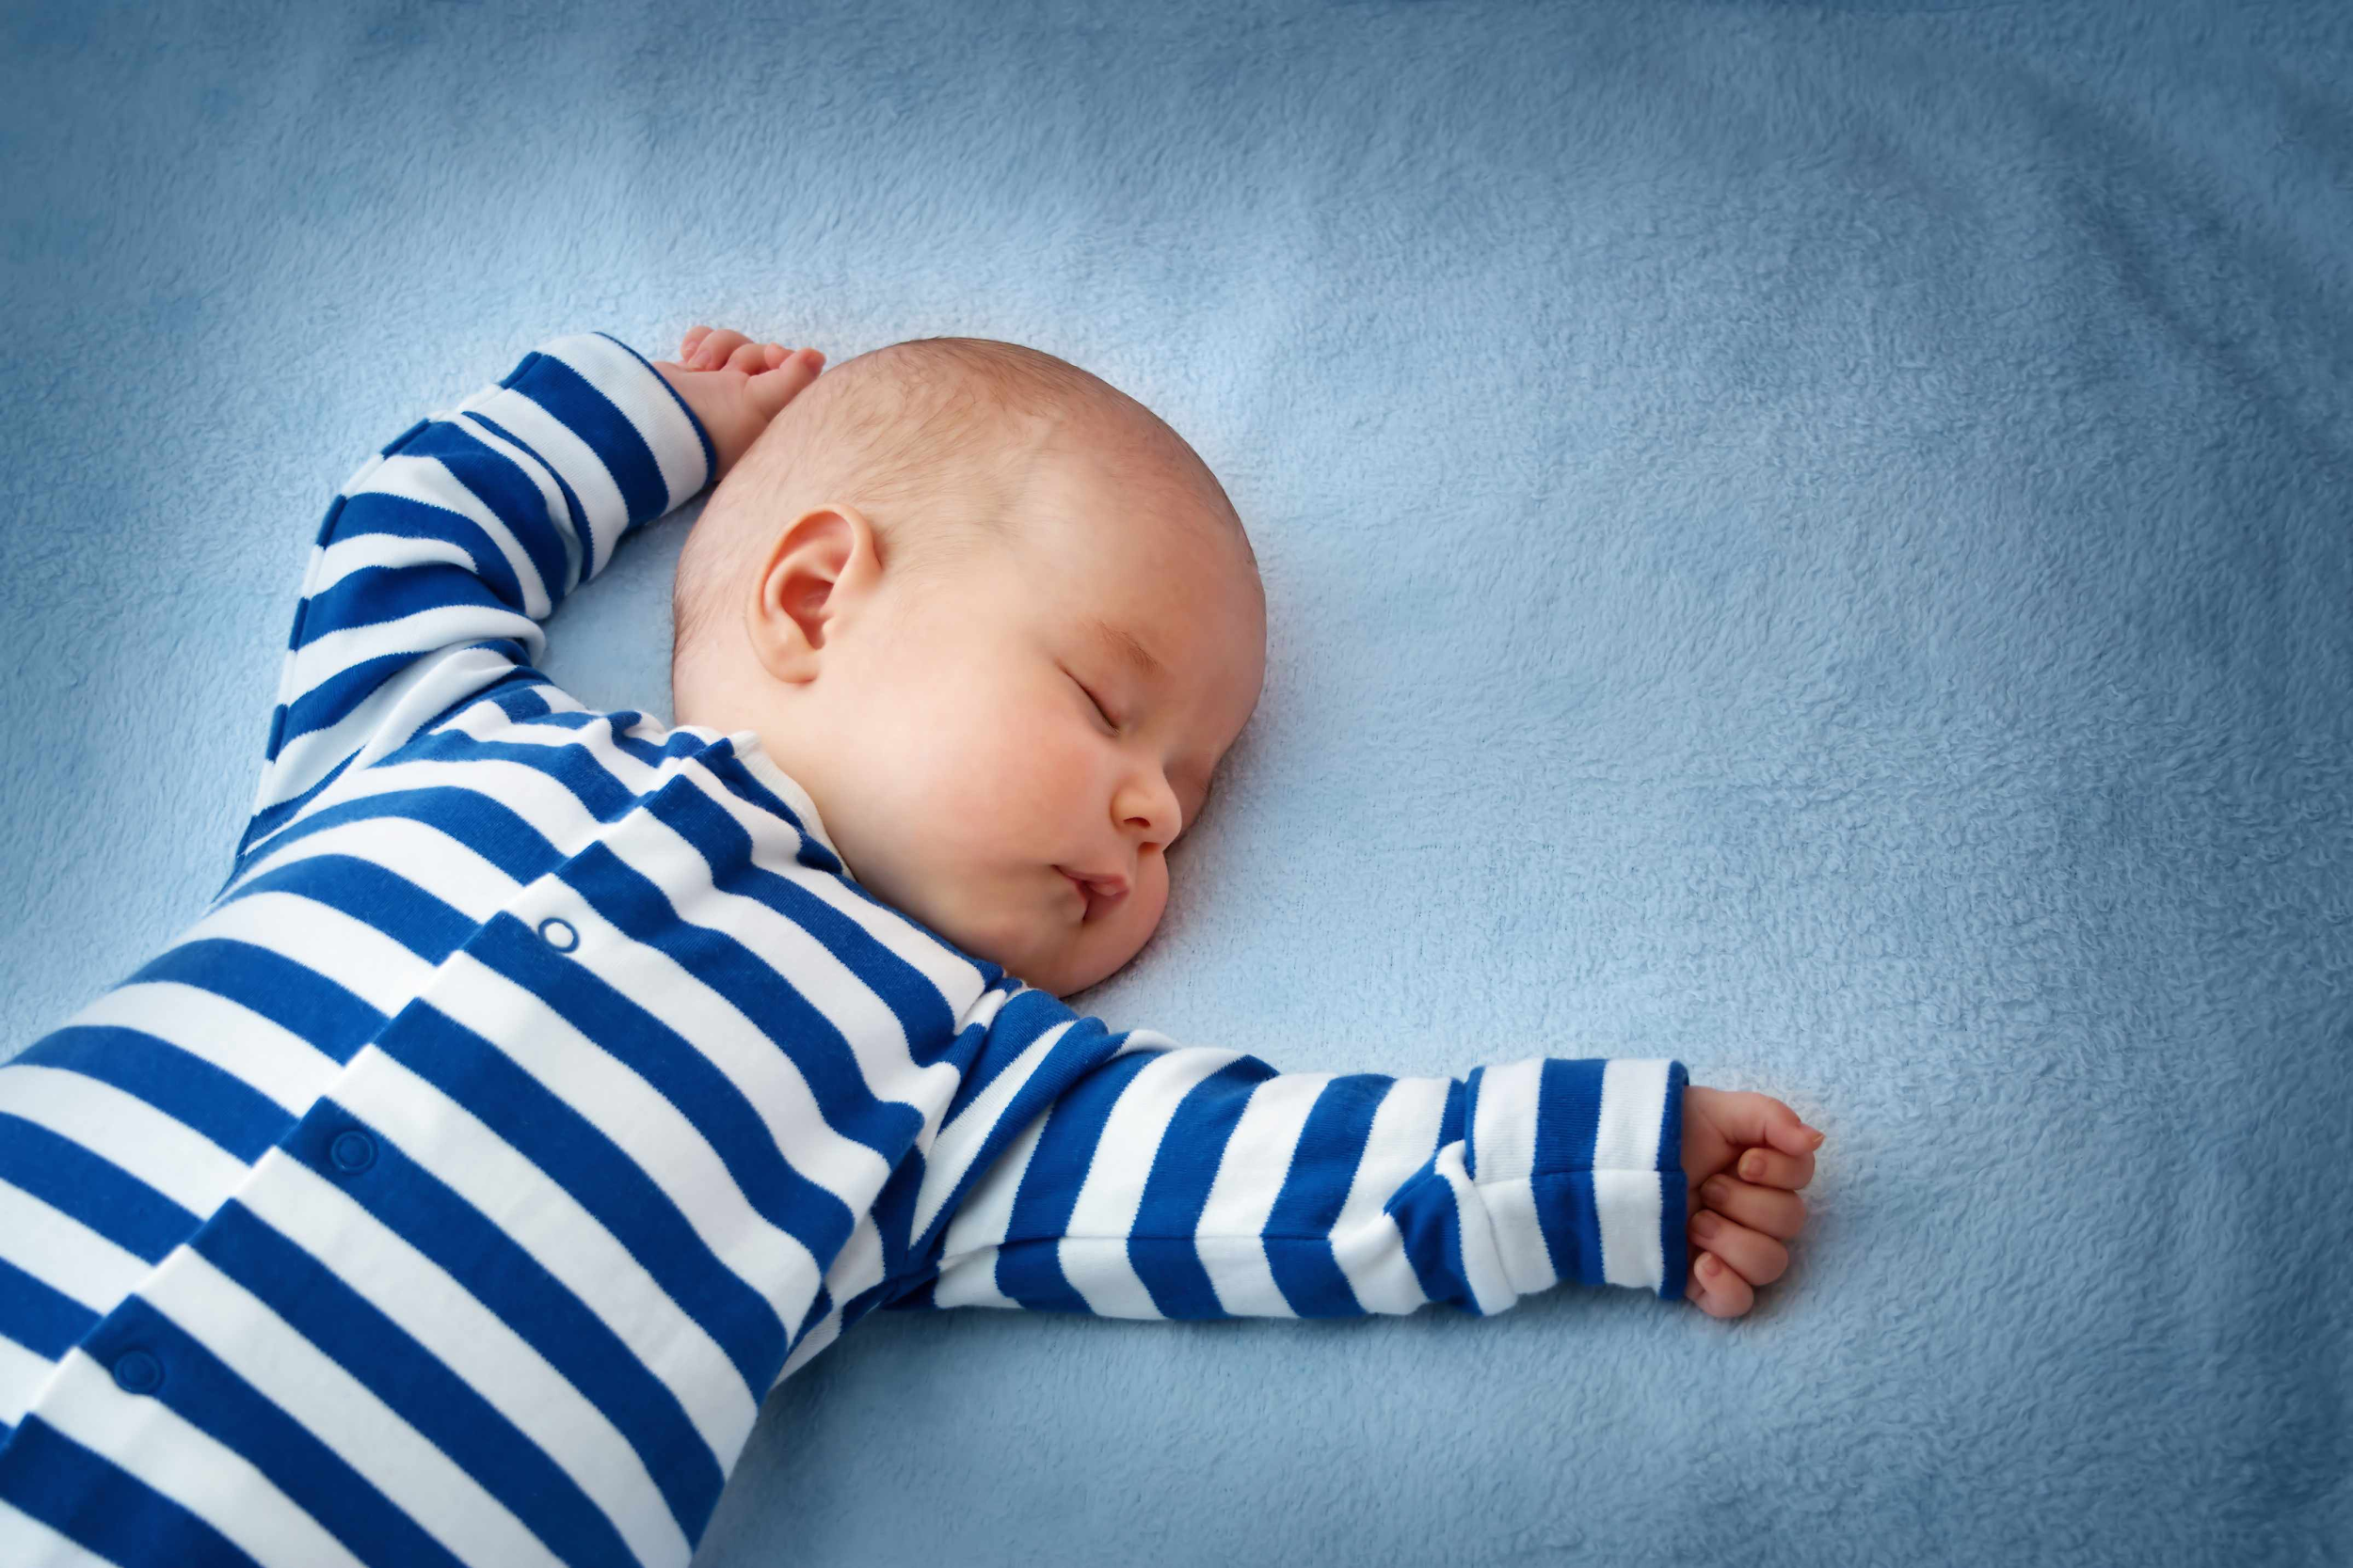
Sleeping On Your Left Side
https://www.youtube.com/watch?v=UbElZBptFZg
Notes:
beth

Slide 11
In Summary
Sleep hygiene is important for getting a good night's sleep
While you’re sleeping, your body is “resetting and healing” it also helps prevent certain diseases and keeps you healthy
There are many options for mattress and pillow types, find what’s best for you
Notes:
brianna

Slide 12
If you don’t practice good sleep hygiene
Your immune system will weaken and you have a higher chance of being susceptible to pathogens therefore making it easier to get sick.
Your heart suffers and you are more likely to develop coronary heart disease as well as being at risk for a stroke.
Shortened sleep is associated with higher rates of breast cancer, colorectal cancer, and prostate cancer as well as increasing your risk of diabetes and being obese.
You can’t think as clearly and it is harder to decision make, reason, and problem solve, along with worsening reaction time and alertness that is associate with being accident prone.
Your looks will suffer. Your body needs resting time to replenish your skin.
Notes:
brianna

Slide 13
References
https://www.tuck.com/sleep-hygiene/
https://www.healthline.com/health/healthy-sleep/what-happens-to-your-body-when-you-lose-sleep#5
https://bettersleep.org/mattress-education/mattress-accessories/pillow-types/
https://www.thesleepdoctor.com/2017/05/22/benefits-exercise-sleep/
http://healthysleep.med.harvard.edu/healthy/getting/overcoming/tips

